Slide 1
Introduction to Data Structure
Name : Rupak Sarkar Roll No.: 14271024036 Stream : MCA Semester : Semester 2nd Subject : Data Structure with Python Subject Code : MCAN-201

Slide 2
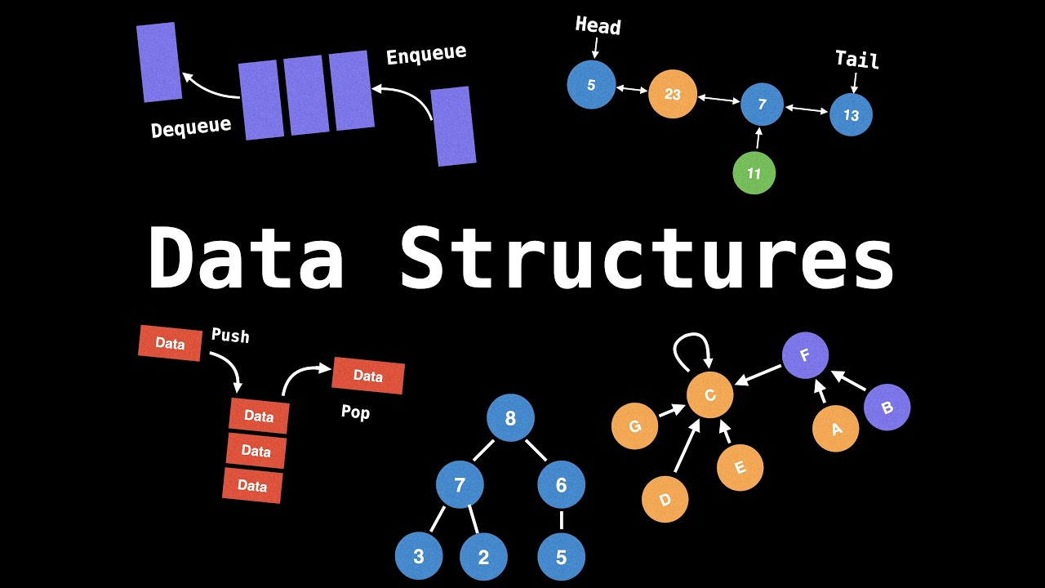
Definition of Data Structure
Data structures are the fundamental building blocks of computer programming. They define how data is organized, stored, and manipulated within a program.
A data structure is a storage that is used to store and organize data.
It is a way of arranging data on a computer so that it can be accessed and updated efficiently.
A data structure is not only used for organizing the data.
It is also used for processing, retrieving, and storing data.

Slide 3
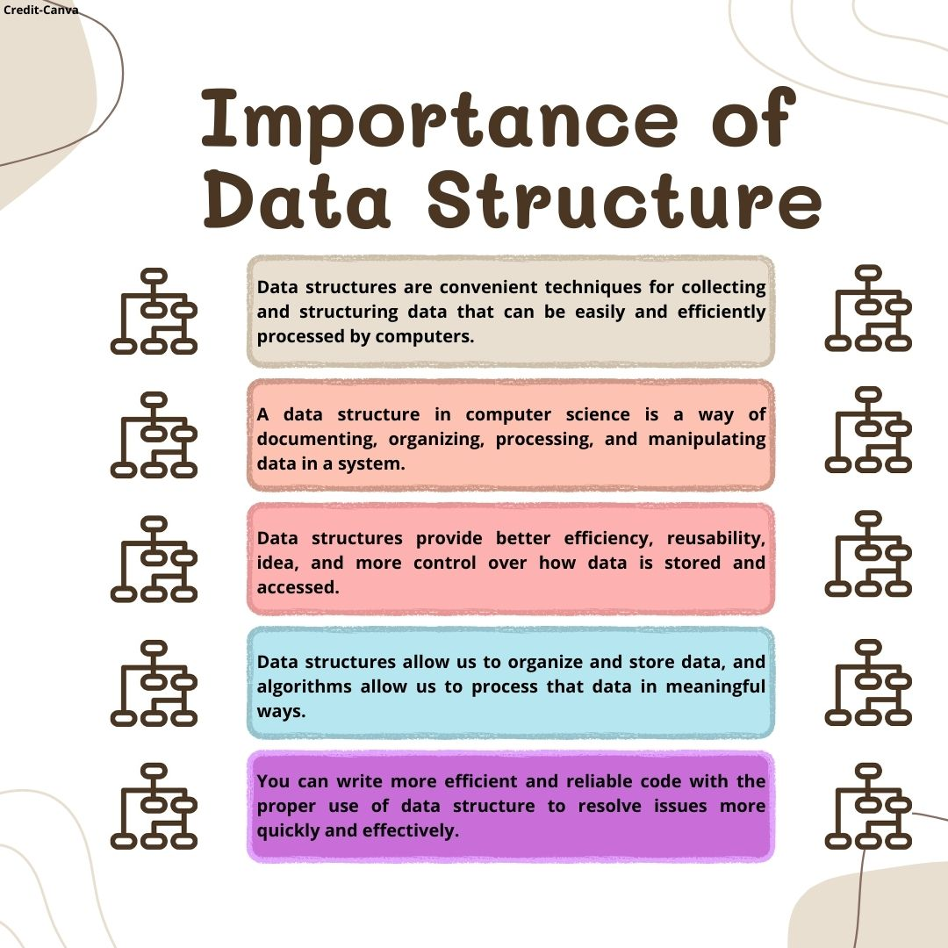
Why should we use Data Structure?
Data Structures are structures programmed to store ordered data, so that various operations can be performed on it easily.
A data structure in computer science is a way of documenting, organizing, processing, and manipulating data in a system.
Data structures provide an efficient way to organize, manage, and store data.
Data structures ensure efficiency, reusability, and abstraction.
Data structures allow us to organize and store data, and algorithms allow us to process that data in meaningful ways.

Slide 4
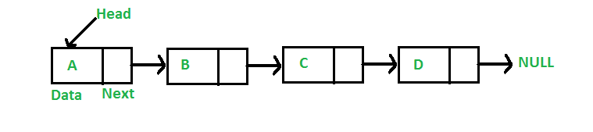
Different types of Data Structures
Linked List
A Linked list is a linear data structure in which elements are not stored at contiguous memory locations.
Linked lists are used to implement other data structures like stacks, queues, etc.
It is used for the representation of sparse matrices.
It is used in the linked allocation of files.
Linked lists are used to display image containers.
Users can visit past, current, and next images.
They are used to perform undo operations.

Slide 5
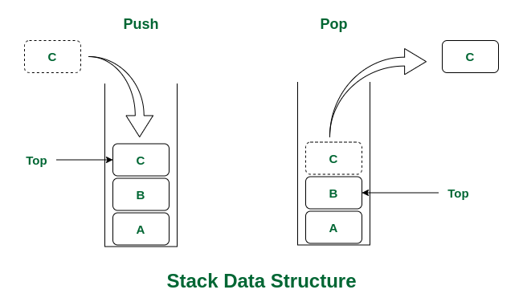
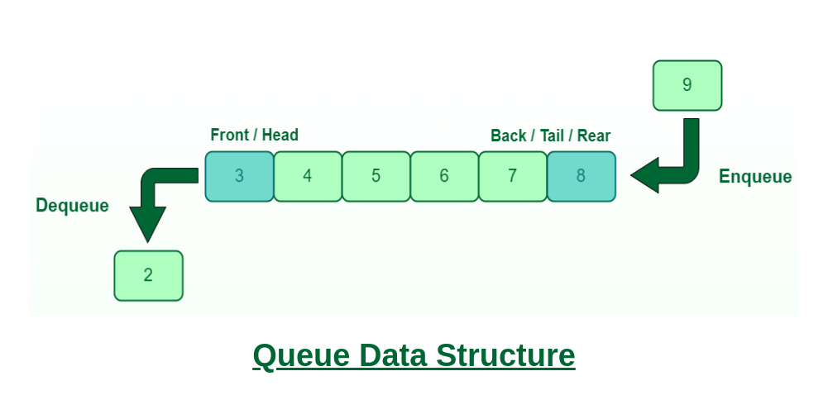
Different types of Data Structures
Stack
Stack is a linear data structure that follows LIFO(Last in first out) principle.
The stack data structure is used in the evaluation and conversion of arithmetic expressions.
It is used for parenthesis checking and string reversal.
Queue
Queue is a linear data structure that follows First In First Out(FIFO) principle.
Queue is used for handling website traffic.
Queues are used for job scheduling in the operating system.

Slide 6
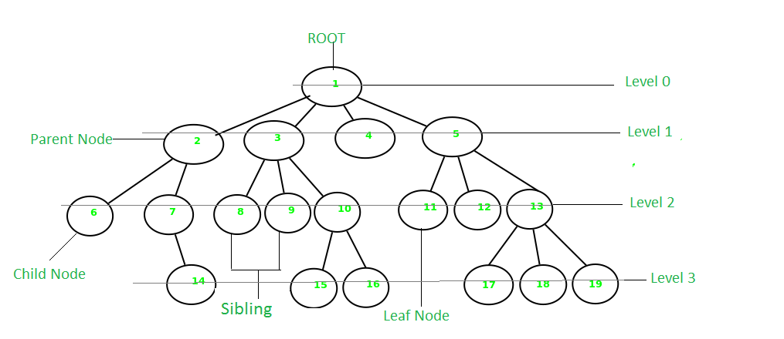
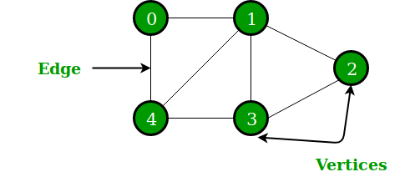
Different types of Data Structures
Tree
A Tree is a non-linear and hierarchical data structure where the elements are arranged in a tree-like structure.
Spanning trees are used in routers in computer networks.
Domain Name Server also uses a tree data structure.
Graph
A Graph is a non-linear data structure that consists of vertices (or nodes) and edges.
The operating system uses Resource Allocation Graph.
Also used in the World Wide Web where the web pages represent the nodes.

Slide 7
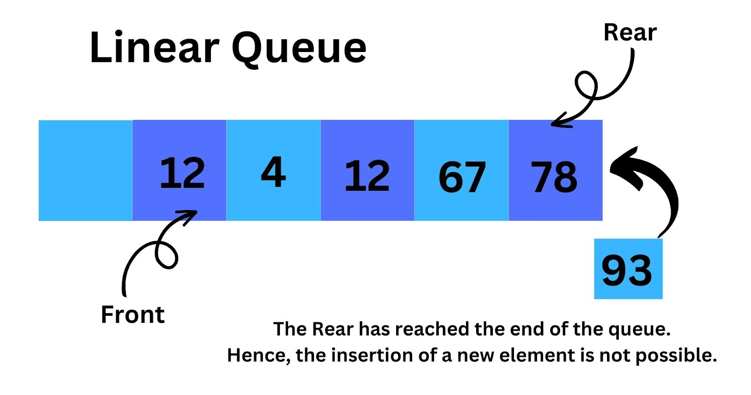
What is Linear Queue?
A linear queue is a straightforward implementation of the queue data structure. It follows the First-In-First-Out (FIFO) principle. It is a linear data structure where elements are added at one end (the rear) and removed from the other end (the front).
Structure: Utilizes a linear array or linked list to store elements.
Operations: Insertion (enqueue) happens at the rear, and deletion (dequeue) occurs at the front.
Index Management: Uses two pointers or indices: front and rear. The front points to the first element, and the rear points to the last element.
Growth: The rear index moves towards the end of the array with each addition, and the front index moves towards the end with each removal.

Slide 8
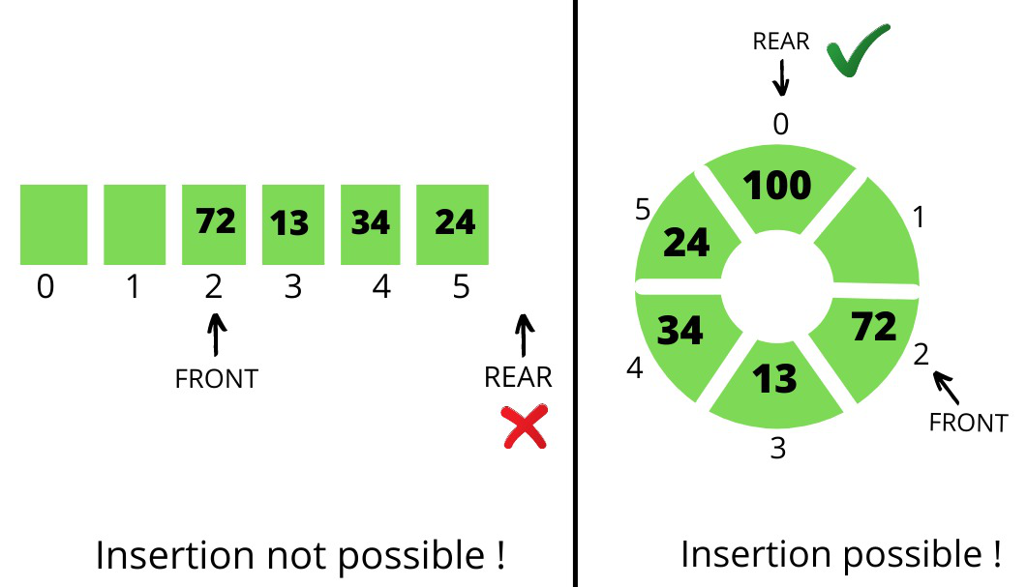
Drawbacks of Linear Queue
Linear queues can be inefficient, especially when dealing with large numbers of elements.
Unused space can accumulate at the beginning of the array, leading to wasted memory.
The empty spaces in the front are not utilized until the queue becomes empty.
Once the queue reaches its maximum size, it cannot accept new elements until some are removed.
In fixed-size array implementations, the queue cannot reuse the vacated spaces.

Slide 9
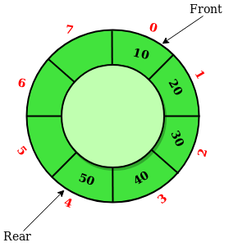
Circular Queue and its Advantages over Linear Queue
A Circular Queue is an extended version of a normal queue where the last element of the queue is connected to the first element of the queue forming a circle.
Structure: Uses a circular array or linked list to store elements.
Operations: Similar to linear queues but with circular index management.
Index Management: Both front and rear pointers move in a circular manner. When the rear or front reaches the end of the array, it wraps around to the beginning.
Efficiency: This design ensures all available memory is utilized efficiently.

Slide 10
Thank You!

